Slide 1
BME 790 Spring 2017 Weekly Summary
Author: Daniel A Hagen
Week: 01/30/17-02/05/17 Relevant Topics: co-vectors, one-forms, connection vector fields, Noether's Theorem, no-slide and inertial constraints locomotion

Slide 2

Covectors and one-forms
Before we address this week’s main topics (connection vector fields, kinematic reconstruction equation, etc.) it is important to discuss covectors and one-forms.
A cotangent space ($T_{q}^{∗}Q$) is a dual space to a (tangent) vector space ($T_{q}Q$) attached to any point on a manifold. Every element in $T_{q}^{∗}Q$ (covector) is a linear functional (map) of $T_{q}^{ }Q$ that returns the velocity vector into a scalar quantity.
More generally, a covector can be thought of as a vector quantity that has the same dimension as a tangent vector that produces a scalar value through the product with a tangent vector.
Whereas tangent vectors possess “velocity”-like terms that describe motion through the space, covectors possess “gradient”-like terms to describe how a value varies across the space.
If $ω$is a function of the configuration space ($q$) this represents a collection of covectors, i.e. a vector field. These functions ($ω(q)$) are known as (differential) one-forms.
As demonstrated on the next slide, multiple covector fields may be combined to produce vector-valued one-forms.
Note: Superscripts are used when indexing covectors instead of subscripts, and the musical notion of “sharp” (#) is used to reflect that “lifting” of the indexing.

Slide 3
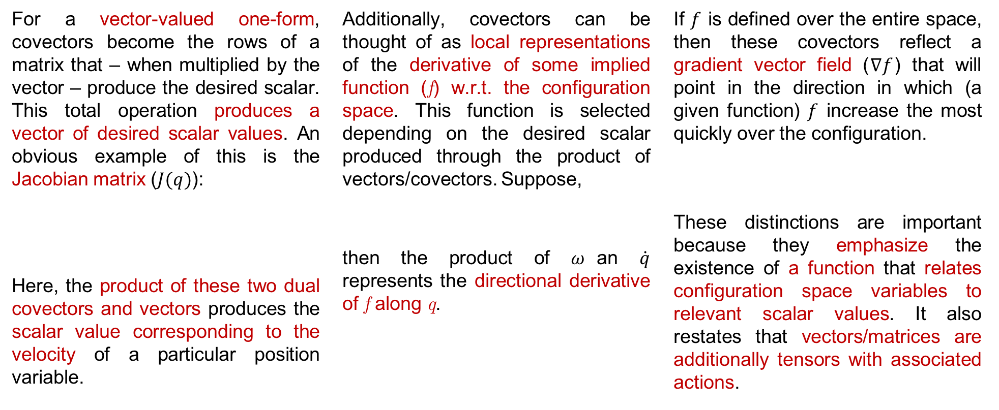
Covectors and one-forms
For a vector-valued one-form, covectors become the rows of a matrix that – when multiplied by the vector – produce the desired scalar. This total operation produces a vector of desired scalar values. An obvious example of this is the Jacobian matrix ($J(q)$):
Here, the product of these two dual covectors and vectors produces the scalar value corresponding to the velocity of a particular position variable.
Additionally, covectors can be thought of as local representations of the derivative of some implied function (f) w.r.t. the configuration space. This function is selected depending on the desired scalar produced through the product of vectors/covectors. Suppose,
then the product of $ω$an $\dot{q}$ represents the directional derivative of f along q.
If $f$ is defined over the entire space, then these covectors reflect a gradient vector field ($∇f$) that will point in the direction in which (a given function) $f$ increase the most quickly over the configuration.
These distinctions are important because they emphasize the existence of a function that relates configuration space variables to relevant scalar values. It also restates that vectors/matrices are additionally tensors with associated actions.

Slide 4
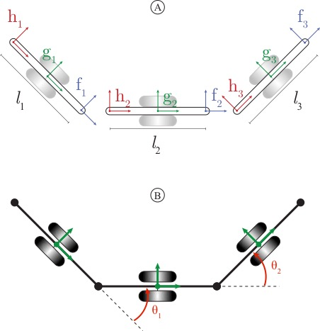
No-Slide 3-Link Locomotor
Below is a 3-link kinematic locomotor with wheels at the link body frames that each have a ”no slide” condition.
The body frame velocities can be calculated by considering the middle link body frame to be the overall body frame.
The second term of each velocity vector must be zero to ensure that the 3-link ”snake” does not move ”laterally” at the wheels (i.e., “no slide”). Therefore, the Pfaffian constraints of the system are:

Slide 5
Noether’s Theorem
In short, Noether’s Theorem states that if a system is symmetric with respect to a given transformation, then some value is conserved in that direction.
This theorem allows for the calculation of conserved quantities (invariants) from observable symmetries and vice versa. Therefore, it is possible to take a system with an observable symmetry and find a value that is conserved, or a system can be imagined to have a given conserved value and the resulting symmetry can be obtained (thus allowing for a way to test models).
This becomes particularly important when attempting to reduce the necessary equations of motion by “ignoring” a given coordinate over which the symmetry is observed.
A simple example is a system that is symmetrical to horizontal translations (i.e., horizontal translation does not affect the Lagrangian of the system). Because of this symmetry, the linear momentum will be preserved in this direction.

Slide 6
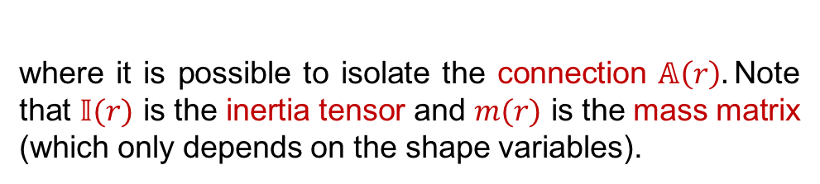
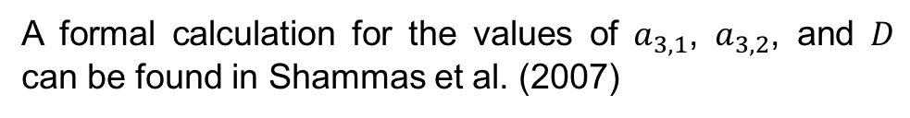
Inertial Constraints (3-Link Locomotor)
An illustration of this concept can be seen in systems with inertial constraints (and cleverly chosen coordinate frames).
However, it is possible to find the local connection from the energy of the system. For this “floating snake” there is no potential energy, indicating that:
For the 3-link locomotor, if we select the center of mass as the x,y location of the body frame, then the Lagrangian will not change with translations in either x or y (i.e. translational velocity does not depend on the Cartesian coordinates of the body frame). Therefore, the local connection can be more easily obtained as:
where it is possible to isolate the connection $𝔸\left(r\right).$Note that $𝕀(r)$ is the inertia tensor and $m(r)$ is the mass matrix (which only depends on the shape variables).
These techniques allow for a formulation of the local connection, which allows for insight into the behavior of the system to changes in the shape variables.
A formal calculation for the values of $a_{3,1}$, $a_{3,2}$, and $D$ can be found in Shammas et al. (2007)

Slide 7
Conclusions/Impressions
We are working towards a better understanding of how to incorporate these principles in trajectory (gait) formulation. Consequences to shape variable trajectories on the position of a system are not only elucidated by the connection of a system, but are also utilized to find movement trajectories that satisfy given criteria.
Formulating the system properly, by either the use of a clever coordinate frame or the selection of systems with natural symmetries, allows for simpler formulation of the equations of motion through the use of Noether’s theorem. Additionally, this allows for a simpler construction of the Pfaffian constraints and local connections.
References:
Choset, H. and Hatton, RL, 2015. An Introduction to Geometric Mechanics and Differential Geometry
Shammas, E.A., Choset, H. and Rizzi, A.A., 2007. Geometric motion planning analysis for two classes of underactuated mechanical systems. The International Journal of Robotics Research, 26(10), pp.1043-1073.

